Slide 1
User Study Design
Gale Lucas
lucas@ict.usc.edu

Slide 2
Today’s Topics
UX/UI design
AB testing
User study design
Advanced analysis for experiments

Slide 3
UX/UI Design

Slide 4
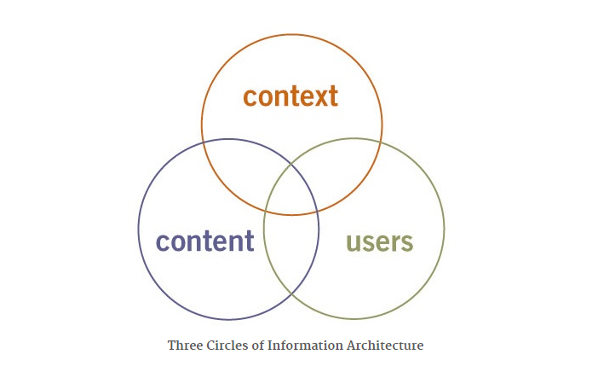

UX/UI Design
Notes:
Context – business goals, funding, politics, culture, tech, resources, constraints
Content – document/data types, content objects, interface structure, volume
Users – Audience, tasks, needs, information seeking behavior, experience
CONTENT is the one we think about most with design, but then when we think about testing the design, we start to think about USERS …. Lets start with content

Slide 5


Content
Ownership
Format
Structure
Metadata
Volume
Dynamism
Notes:
Ownership. Who creates and owns the content? How much is licensed from external vendors? The answers to these questions play a huge role in influencing the level of control you have over the design.
Format. Systems within which we design are becoming monoliths. This forces guardrails around design. EG WORDPRESS
Structure. Some information systems are built around the document paradigm, with the document as the smallest discrete unit. Other systems leverage some form of markup language to allow management and access at a finer level of granularity.
Metadata. To what extent has metadata that describes the content and objects within your system already been created? Have users been allowed to tag the content? These factors can affect the design process.
Volume. How much content are we talking about? How big is your system?
Dynamism. What is the rate of growth? How often will it be updated? And how quickly will it go stale?

Slide 6
UX/UI Design
Notes:
The overlapping circles of UX/UI design do vary in level of concreteness. Content itself is most concrete, the other circles are less concrete – both users and context
As I said CONTENT is the one we think about most with design, but then when we think about testing the design, we start to think about USERS … so now to thinking about users more: next slide

Slide 7
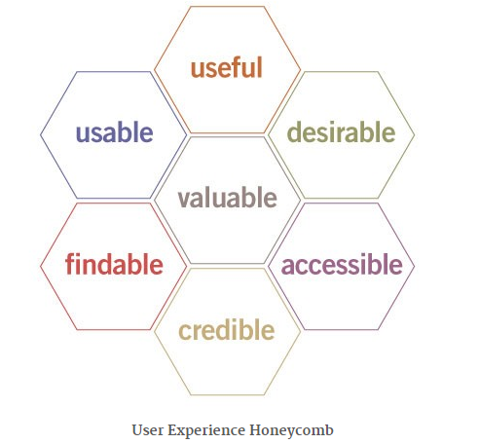
UX Honeycomb
Notes:
Useful. We must ask whether our systems and interfaces are useful, and find innovative solutions that are more useful.
Usable. Ease of use is vital. Unfortunately, the interface-centered methods and research on HCI do not fully model its role. Usability seems necessary, but not sufficient.
Desirable. These factors must be tempered by an appreciation for image, identity, brand, and other emotional elements.
Findable. We must strive to design interfaces and objects that are intuitive, so users can find what they need.
Accessible. Interfaces and systems should be accessible to people with disabilities (10% of the pop.).
Credible. Design elements influence whether users trust and believe what we tell them.
Valuable. Deliverable must deliver value. User experience must advance the mission, contribute to the bottom line, and/or improve customer satisfaction.
Easy to use (usable) for something user needs (useful) that also benefits the owner (valuable)

Slide 8
AB Testing

Slide 9
AB testing
AB testing (bucket tests or split-run testing)
Randomized control trial or experiment with two levels: A and B
Used to test the impact of design element
A design element is an example of a variable
Used to test the impact of design element on user outcomes
Objective
Subjective
Notes:
Specific kind of randomized control trial. As Ive said before, experiment and randomized control trial are often used interchangeably

Slide 10
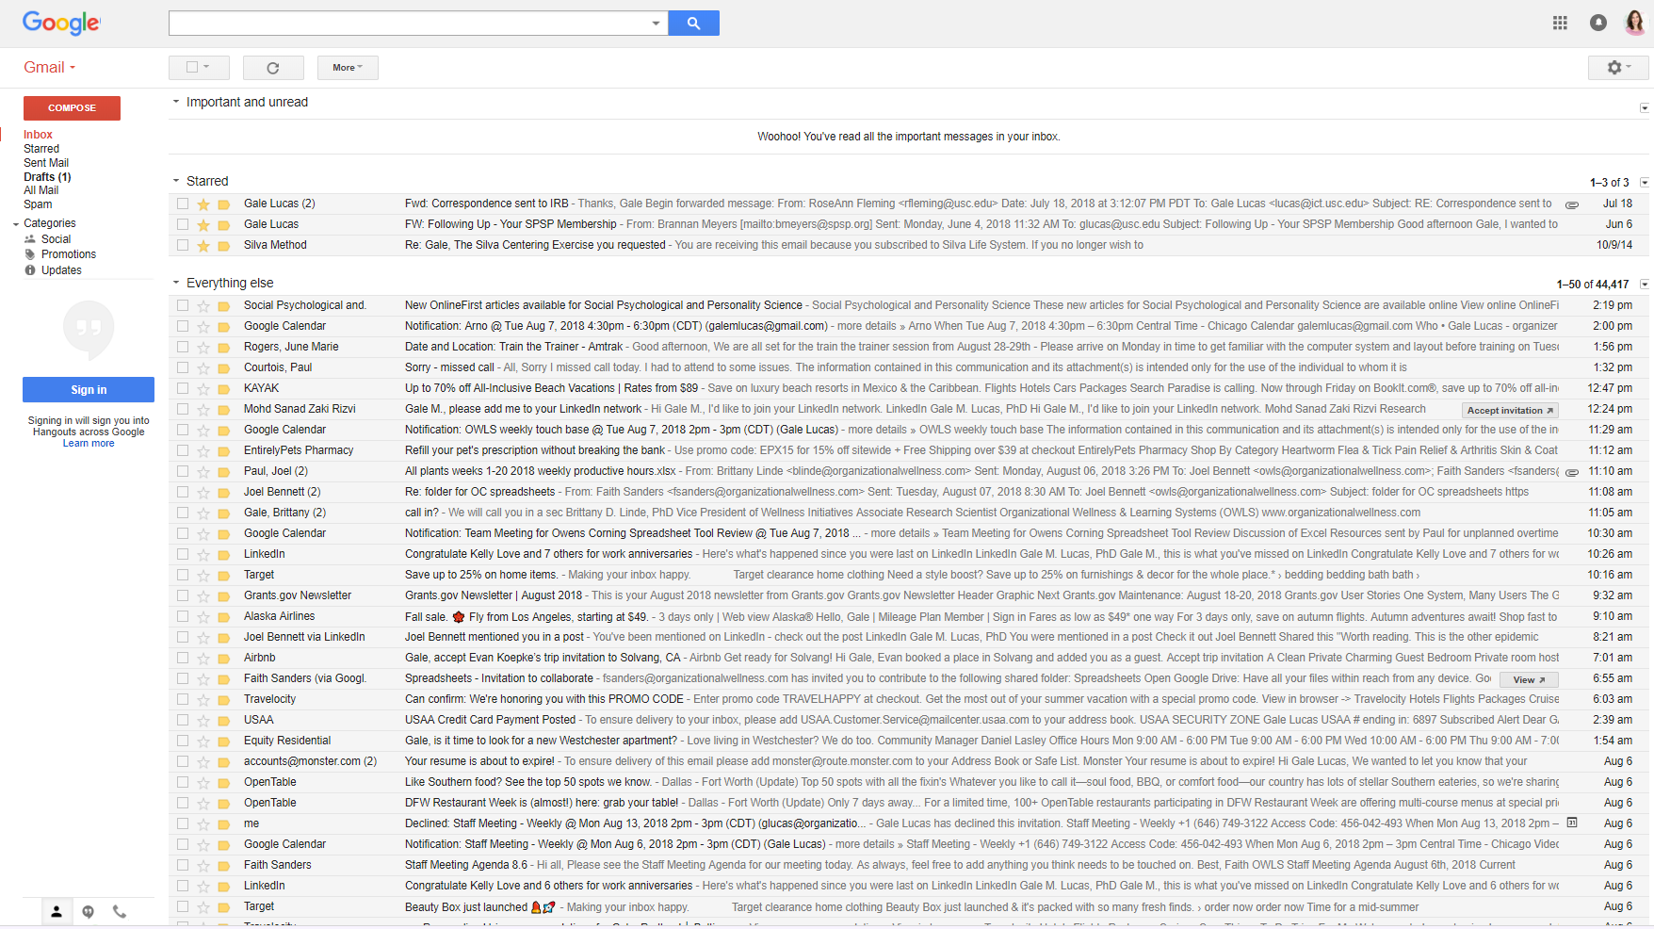
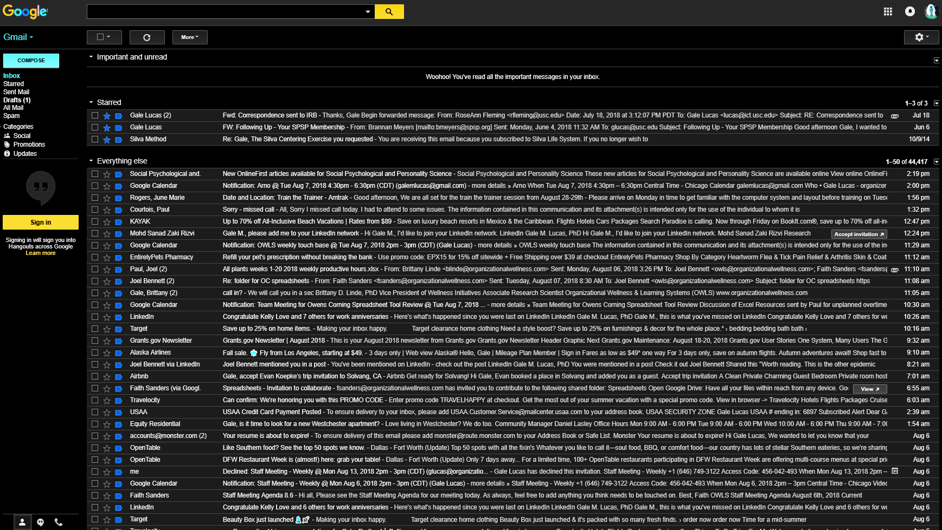
AB Testing
Population of users
Sample
A
B
4 5 6 1 3 6 2 7 7 3 2 7 4 6 7 2 5 5 2 3 7 5 7 3 7 6 7 2 3 7
6 1 7 4 2 5 3 1 2 2 2 4 1 1 3 4 2 5 6 1 4 6 5 1 2 7 7 2 7 2

Slide 11
Conducting AB Testing
Gather random sample from a population
Randomly assign to different conditions that only differ in one way
Random assignment
Differ on one variable
A vs. B – there should be only one difference between A and B
Compare!
Inferential statistics are used to test whether the difference is reliable

Slide 12
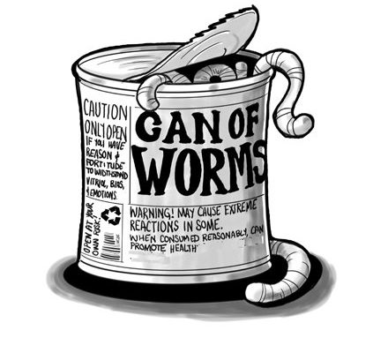
AB Testing
What user outcomes?
What statistical analysis?
User studies
AB Testing
Sometimes need more than just AB testing

Slide 13

AB Testing
AB test of design feature: rapport-building
My name is Niki. What’s your name?
VS.
I’m sorry, I can’t hear you…
I’m sorry, I can’t hear you…

Slide 14
AB testing

Slide 15
Need for more than AB testing
My name is Niki. What’s your name?
VS.
I’m sorry, I can’t hear you…
I’m sorry, I can’t hear you…
My name is Niki. What’s your name?
VS.
VS.

Slide 16
Need for more than AB testing
AB testing would not have been enough
Rapport building hurts only if there’s errors
Also, only a problem if errors occur later, and depends on culture

Slide 17
Basics of user study design

Slide 18
Steps in user study design
Operationalize variables
Choose research design
Collect, analyze and report data

Slide 19
Operationalize variables
Choose your variables, make them concrete
What do you want to study?
Variables (or constructs)
Operational definitions
A clear, measurable definition of a construct

Slide 20
Examples

Slide 21
Examples
My name is Niki. What’s your name?
I’m sorry, I can’t hear you…

Slide 22
Examples
Need to belong
I try hard not to do things that will make people avoid or reject me.
I need to feel that there are other people I can turn to in times of need.
I want other people to accept me.
I do not like being alone.
I have a strong "need to belong".
It bothers me a great deal when I am not included in other people's plans.
My feelings are easily hurt when I feel that others do not accept me.

Slide 23
Operationalize variables
Other examples
Notes:
Trust
Aggression
depression

Slide 24
IVs and DVs
IV: Independent Variable
Variable that you think causes the effect on another variable
DV: Dependent Variable
The outcome variable (you think it has effect on)
PREDICTOR
OUTCOME
Operational definitions
Need to specify for both IV and DV
Notes:
NOW WE ARE TALKING ABOUT user study design or METHODS, so we talk about them in terms of IV and DV --- not call them predictor and outcome anymore… these are variables YOU are setting when you design a study, not just something you are analyzing from a dataset!!!!

Slide 25
Types of Measures
Quantitative
Questionnaires
Task performance
Physiological data
Qualitative
Free Response
Oral Interviews
Observations
Ethnography

Slide 26
Questionnaires
Post-questionnaires can be used to gather feedback after exposure
Pre- and post-questionnaires can be used to measure changes over time
Demographic questionnaires gather information about study participants

Slide 27
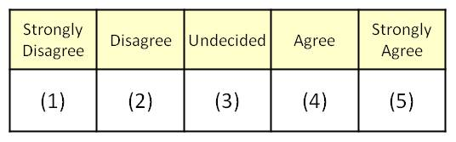
Likert-Type Scales
Participant indicates agreement with statement
Easy to analyze statistically

Slide 28
Questionnaires
Pros
Quick and easy to deploy
Can use standardized, validated measures
Easy to analyze results
Cons
Often subjective (*adds error)
Must be carefully worded to avoid bias

Slide 29
Task Performance
Pros
Objective
Often captured automatically during experiment
Easy to analyze results
Cons
Limited by task participants completed
Sometimes difficult to infer meaning

Slide 30
Physiological Measures
Pros
Objective
Easy to analyze results
Cons
Requires external equipment
Measurement may be intrusive
Sometimes difficult to infer meaning
Noisy (*error)

Slide 31
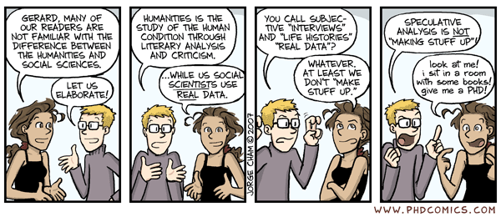
Qualitative Data
Not data in the sense that we talk about in this class!

Slide 32
Putting it all together
Now we can put it all together:
Independent variable vs dependent variable?
Quantitative
Importantly:
any of these could be categorical or continuous…
Questionnaires
Task performance
Physiological data

Slide 33
Putting it all together
Both Independent (IV) and dependent (DV) variables can either be “categorical” or “continuous”
“groups” vs “how much?”

Slide 34
Types of statistical tests
 | Continuous IV (e.g., how much) | Categorical IV (e.g, exp vs control)
Continuous DV (e.g., how much) | correlation or regression | t-test or ANOVA
Categorical DV (e.g., yes/no) | logistical regression | chi-square test or loglinear

Slide 35
Putting it all together
What test(s) could be run with this measure as an dependent variable?
How would you choose which of those it should be?

Slide 36
Putting it all together
What if you wanted to know if, the older respondents were, were they more likely to score higher on this scale?

Slide 37
Steps in user study design
Operationalize variables
Choose research design
Collect, analyze and report data

Slide 38
User study design
User studies
AB Testing

Slide 39
User study design
User studies
Experiment
AB Testing
Correlational research

Slide 40
Experiment
Random assignment to conditions that differ on one variable
People can get both A and B (in different orders)
Variable can have more “levels” than just A & B
Design can be have more than one variable

Slide 41
IVs and DVs
EXPERIMENT
MANIPULATED
PREDICTOR
IV: Independent Variable
Variable that you think causes the effect on another variable
Variable that is manipulated in an experiment
DV: Dependent Variable
The outcome variable (you think it has effect on)
Variable measured in an experiment
MEASURED
OUTCOME

Slide 42
User study design
User studies
Experiment
AB Testing
Between-subjects
Within-subjects

Slide 43
Types of AB Testing
Between-Subjects
Participants assigned to 2 different conditions
Example
Participants experience either experimental condition or control

Slide 44
Types of AB Testing
Within-Subjects
All participants in both conditions
Example
Participants get both experimental and control versions of task
Participants all tested before and after an experience (pre-post design)
Changes over time

Slide 45
Between- vs. Within-Subjects
Between-Subjects
Larger sample size needed
May need to control for variation between individuals
Easier to design and statistically analyze
Within-Subjects
Requires smaller sample size
Less error (individual differences)
Can measure changes over time (pre-post)
Can introduce learning effects (need for counterbalancing if comparing conditions instead)
May not always be possible

Slide 46
Counterbalancing
A | B
B | A
Order 1
Order 2

Slide 47
Measurement
Post-questionnaires can be used to gather feedback after exposure
Pre- and post-questionnaires can be used to measure changes over time
Used for between-subjects or within-subjects design
Used for within-subjects (pre-post) design(s)

Slide 48
User study design
User studies
Experiment
AB Testing
Between-subjects
Within-subjects
AB+ (one-way) design
Between-subjects
Within-subjects

Slide 49
AB+ (One-way) Designs
Between-Subjects
Participants are assigned to one of >2 conditions
E.g., Assigned to drug, talk therapy, or control
Within-Subjects
Participants are assigned to all levels (>2)
E.g., People take versions A and B and C
E.g., People tested before, during, and after

Slide 50
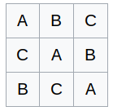
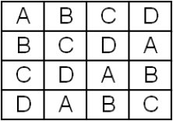
Counterbalancing
Order 1
Order 1
Order 2
Order 2
Order 3
Order 3
Order 4

Slide 51
User study design
User studies
Experiment
AB Testing
Between-subjects
Within-subjects
AB+ (one-way) design
Between-subjects
Within-subjects
Factorial design
Between-subjects
Within-subjects

Slide 52
Factorial design
Between-Subjects
Participants are assigned to one level of each factor
E.g., Men and women are assigned to experiment or control
Within-Subjects
Participants are assigned to all levels of all factors
E.g., People take versions A and B both before and after

Slide 53
Factorial design
Factorial design allows us to tests for an interaction - what is that?
Simple Difficult
Male Female
Female
Male
Simple Difficult

Slide 54
In a 2 X 2 X 2 between-subjects design, how many independent variables are there? How many conditions are there? How many possible main effects are there? How many possible interaction effects are there?

Slide 55
User study design
User studies
Experiment
AB Testing
Between-subjects
Within-subjects
AB+ (one-way) design
Between-subjects
Within-subjects
Factorial design
Between-subjects
Within-subjects
Mixed design

Slide 56
Types of Experimental Designs
Mixed Designs
Participants assigned to different groups (between-subjects)
Participants also test multiple times (within-subjects)
Example
Participants are assigned to experimental or control condition. Pre-test and post-test scores are taken.
Notes:
Eg depression

Slide 57
Counterbalancing
If within-subjects requires counterbalancing, should use a mixed design
Participants tested in multiple conditions (not just a pre-post design), so counterbalancing is required
Order assigned as a between-subjects variable
Test if it has an effect or interaction

Slide 58
Mixed design with
counterbalancing
Simple Difficult
Order 1 Order 2
Order 2
Order 1
Simple Difficult

Slide 59
Advanced analysis for experiments

Slide 60
Experiment
Random assignment to conditions that differ on one variable
Analyze based on whether dependent and independent variables are categorical or continuous

Slide 61
Types of statistical tests
 | Continuous IV (e.g., how much) | Categorical IV (e.g, exp vs control)
Continuous DV (e.g., how much) | correlation or regression | t-test or ANOVA
Categorical DV (e.g., yes/no) | logistical regression | chi-square test or loglinear
independent samples t-test
paired samples t-test
one-way ANOVA
repeated measures ANOVA
factorial ANOVA

Slide 62
Which test for what design?
User studies
Experiment
AB Testing
Between-subjects
Within-subjects
AB+ (one-way) design
Between-subjects
Within-subjects
Factorial design
Between-subjects
Within-subjects
Mixed design
independent samples t-test
paired samples t-test
one-way ANOVA
repeated measures ANOVA
factorial ANOVA

Slide 63
Which test for what design?
User studies
Experiment
AB Testing
Between-subjects
Within-subjects
AB+ (one-way) design
Between-subjects
Within-subjects
Factorial design
Between-subjects
Within-subjects
Mixed design
independent samples t-test - compares 2 separate groups
paired samples t-test - compares 1 group tested twice
one-way ANOVA - compares >2 separate groups
repeated measures ANOVA - compares 1 group tested x2+
factorial ANOVA - compares multiple independent variables

Slide 64
Which test for what design?
User studies
Experiment
AB Testing
Between-subjects
Within-subjects
AB+ (one-way) design
Between-subjects
Within-subjects
Factorial design
Between-subjects
Within-subjects
Mixed design
independent samples t-test
paired samples t-test
one-way ANOVA
repeated measures ANOVA
factorial ANOVA
repeated measures ANOVA
repeated measures ANOVA with between-subjects factor added

Slide 65
Testing for interaction
If did not test for an interaction:
Would miss important nuance

Slide 66
Return to our example
My name is Niki. What’s your name?
VS.
I’m sorry, I can’t hear you…
I’m sorry, I can’t hear you…

Slide 67
Return to our example

Slide 68
Return to our example
My name is Niki. What’s your name?
VS.
I’m sorry, I can’t hear you…
I’m sorry, I can’t hear you…
My name is Niki. What’s your name?
VS.
VS.

Slide 69
Return to our example
Rapport building hurts only if there’s errors

Slide 70
Testing for interaction
If did not test for an interaction:
Would miss important nuance
Conditions under which an effect occurs
Kinds of people for whom an effect occurs
Might think there is no effect
Female
Male
Simple Difficult
Female
Male
Simple Difficult

Slide 71
Testing for interaction
How to tests for an interaction:
Do NOT run a t-test on gender and another on difficulty
ANOVA: which kind?
Factorial ANOVA or repeated measures
What if the other variable is continuous (e.g., age)?
Regression or logistic regression

Slide 72
Advanced analysis for experiments
What if people are studied in pairs (husband & wife, child & parent, two friends (but each randomly assigned to a condition), etc.?

Slide 73
Today’s Topics
UX/UI design
AB testing
User study design
Advanced analysis for experiments

